Slide 2
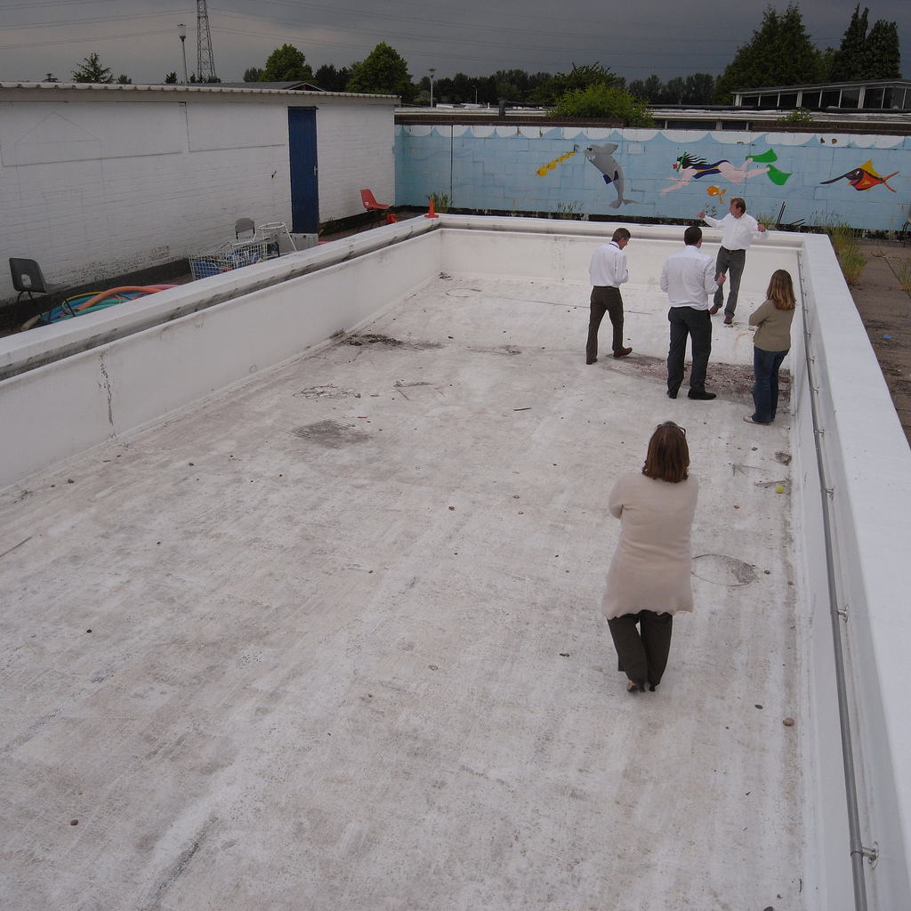

Slide 3
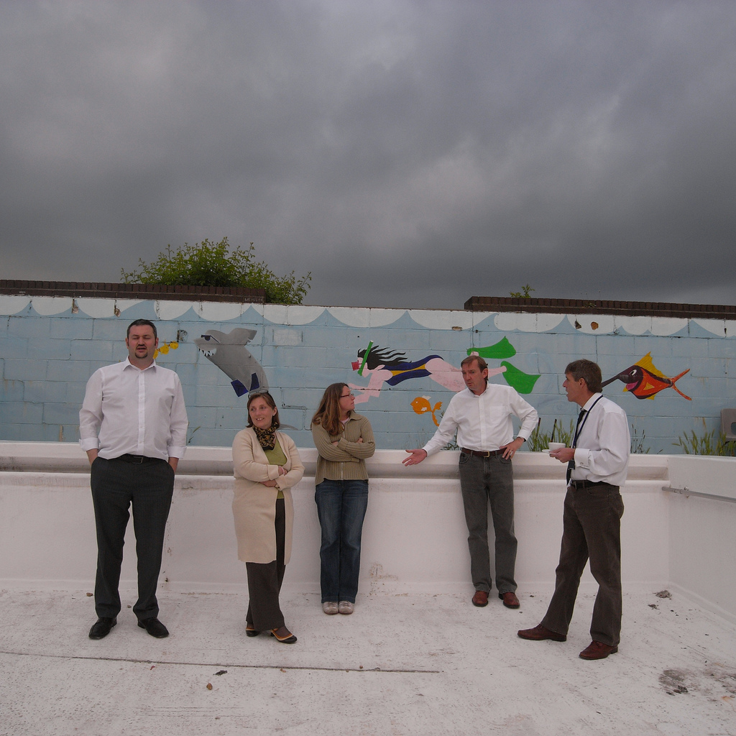

Slide 4
Multi diversity bio dome
The Big Idea Competition
Lewis Cohen and Nicolai Landschultz

Slide 5
Concept
Bio dome
  Two zones: Rainforest and Savannah
  Natural fauna and flora, growing exotic fruits and vegetables
Educational Benefit
  Diversity of Eco-systems
  Sustainability
  Active participation by students
Community Cohesion
  Opportunity to improve their knowledge and experience of growing with their counterparts from around the world
  Open to other schools
Sustainable build
  Reduce carbon footprint of school
  Self-sufficiency, use of produce in school
Links to original site usage
  Retaining pool area for ‘native lakes’
  Will become “a thing of beauty for generations of Fair Field children“

Slide 6
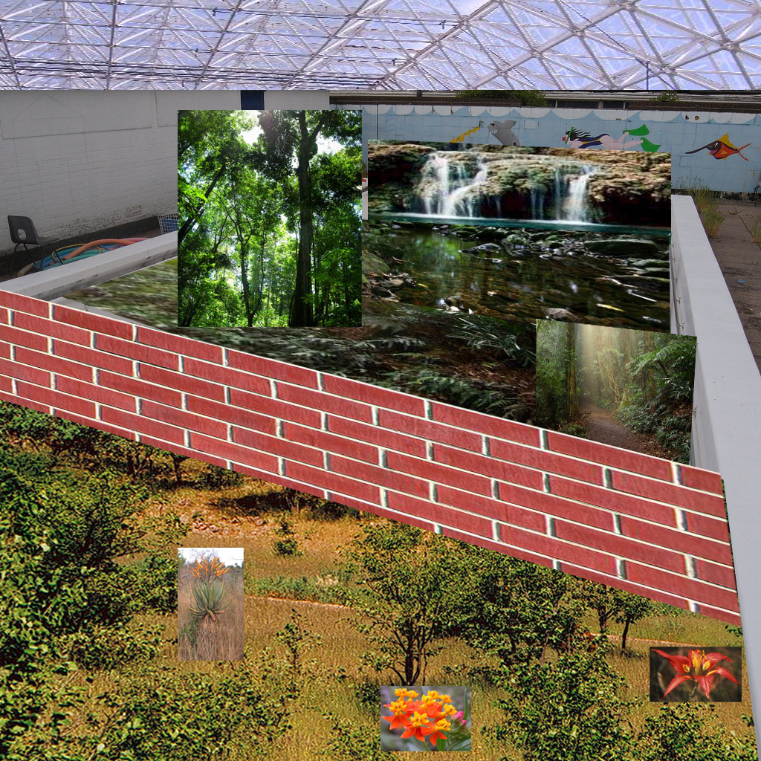
Graphics
Bio Dome Roof
Retain mural
Rainforest
Dividing Wall
Preferably Glass
Savannah

Slide 7
Assumptions
Build
  Use existing structure wherever possible to keep cost low and minimise planning issues, with existing outer walls as the outside boundary of the building.
  Any rubble recycled for infill and recycled materials used for build where possible
Maintenance
  Low running cost, stable micro environment
  Use of heat exchangers and solar panels will minimise running cost
Funding
  Cost focused on higher capital and lower running cost
  Grants and sponsorship available
Education
  Create an innovative and valuable learning resource for pupils
  As a minimum, suitable for the curriculum for year 3 to year 6
Children
  Involved in maintenance and up-keep
  Children to influence final design
Health & Safety
  Create a safe and secure learning environment for children of all ages
  Inclusive and accessible environment

Slide 8
References
Montreal Bio dome
  http://en.wikipedia.org/wiki/Montreal_Biodome
Eden Project Gardens for Life
  http://www.edenproject.com/gardens-for-life/

